Slide 1
California State Universities
Reimbursement Accounts
2024 Plan Year

Slide 2
What are Reimbursement Accounts?
Title of Presentation
Reimbursement Accounts
Year-to-year account
Set aside pretax dollars
Pay for current year expected expenses
May enroll in any health insurance plan
General-Purpose Health Care FSA
Deductibles, Co-Pays, Office Visits, Medical, Dental, Vision
Dependent Care FSA
Daycare, after-school care, pre-school, nursery school

Slide 3
How does it work?
Title of Presentation
It’s easy!
Estimate expenses you expect to incur during the plan year
Make pretax contributions each payday to your FSA(s)
Incur eligible expenses during the plan year
Use debit card for health care expenses, or submit a claim
Pay the provider directly; or be reimbursed to your bank account

Slide 4
What’s in it for me? FSAs give you a pay raise!
Don’t lose out!
Title of Presentation

Slide 5
Things you need to know – IRS rules
Title of Presentation
Enroll every year with a new election
Spend all funds during the year
Expenses must be incurred during your period of coverage, or plan year
Do not have to be covered under employer health insurance
Use to pay expense for spouse and dependent children
Election remains in effect for the plan year unless you experience a qualified status change
Can access all health care funds anytime during the year
Funds remaining at year end are forfeited
Grace Period 2 ½ months through March 15

Slide 6
How to avoid forfeitures
Title of Presentation
Its easy!
Plan for predictable and recurring expenses
Expenses you know you will have during the year
Review prior year expenses as a guide
Be conservative
Use online tools at www.asiflex.com
Expense estimator
Eligible expense listing
FSAStore.com resource for OTC products
And remember, you have an additional 2 ½ months to spend!

Slide 7
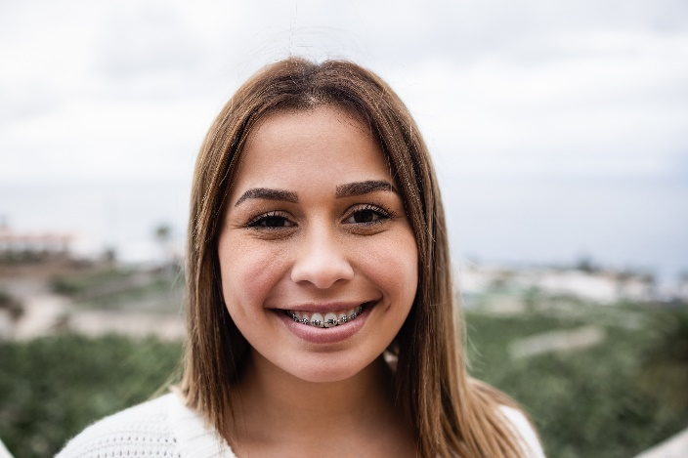
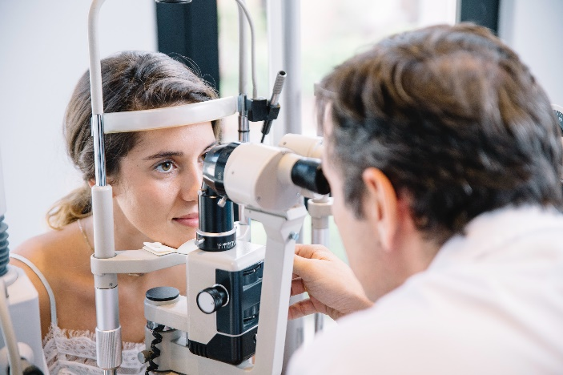
Health Care Expenses
Title of Presentation

Slide 8
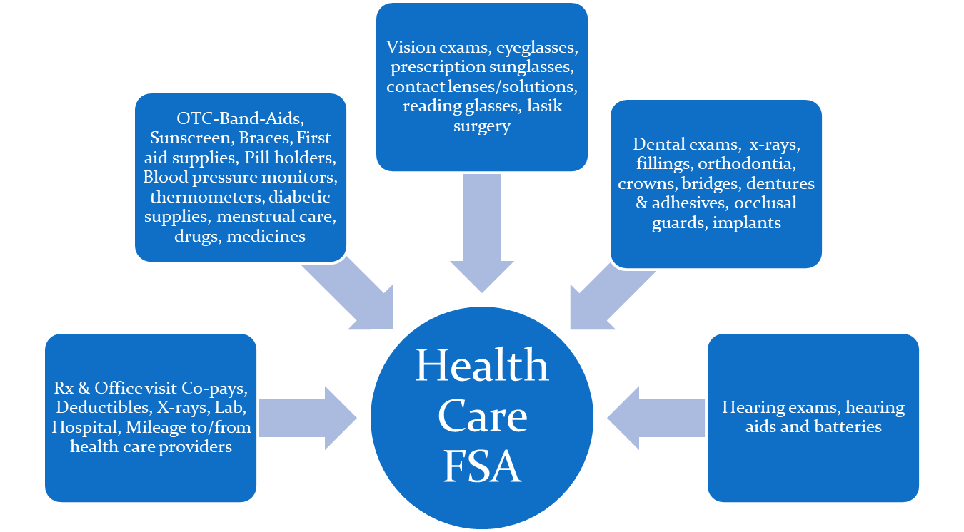
General-Purpose Health Care FSA - $240 to $3,050
Title of Presentation

Slide 9
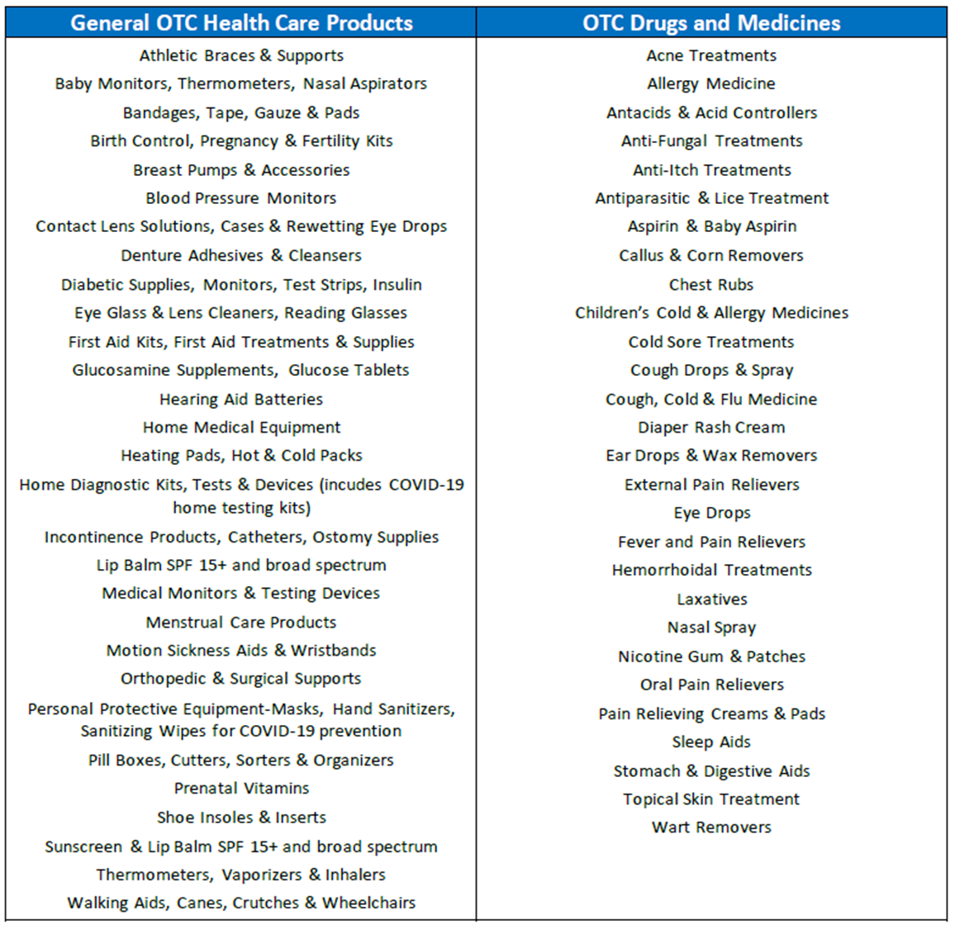
Over-the-Counter Health Care Products
No prescription required!
Title of Presentation

Slide 10
Health Care Funds Available Anytime
Title of Presentation
Plan pays up to plan year election amount, minus paid claims
Example:
Contribute $100 per month = $1,200 plan year
March 31 you incur $500 expense
Year-to-date contributions = $300
Plan pays $500

Slide 11
Sample planning worksheet
Title of Presentation
My expected expenses for my family | Annual dollar amount
Monthly prescription copays – 2 at $30 each | $720
Office visit copays – 2 at $50 each | $100
Dental – crown | $500
Vision – eyeglasses | $350
Vision – prescription sunglasses | $400
Vision – contact lenses | $300
Over-the-counter items – sunscreen, bandages, contact lens solutions | $100
Mileage for driving to and from health care provider locations – 300 miles @ $.22* per mile | $66
MY TOTAL EXPECTED EXPENSES | $2,536
*Based on 2022 IRS mileage rate.

Slide 12
Dependent Care Expenses
Title of Presentation

Slide 13
Dependent Care - $240 to $5,000*
Dependent Care FSA
Babysitting while you work
Preschool or nursery school for young children
Before school or after school care
Day camps
For children under age 13
For child age 13+ or adult if not capable of self-care
Title of Presentation
*$2,500 if married and filing separate income tax returns

Slide 14
Plan Pays up to Cash Balance
Title of Presentation
Example for calendar year plan
Contribute $300 per month = $3,600 plan year
January 31 you incur $500 expense
Year-to-date contributions = $300
Plan pays $300
Plan pays $200 balance after next contribution is made

Slide 15
Multiple Claim Filing Options
Option | Description
Mobile App | Snap picture of documentation and submit via the app
Online | Scan image of documentation and submit online
ASIFlex Card | Pay health care provider at point of service/sale; keep documentation and submit upon request
FSA Store Cardless Pay | Sign into ASIFlex account, and shop FSA Store. No credit or debit card needed; ASIFlex pays FSAStore from your account
Recurring Direct Pay | Sign up online to set up recurring payments to daycare provider
Automatic Reimbursement | Complete claim form to request automatic reimbursements for dependent care
Toll-free Fax | Complete claim form and fax to ASIFlex
USPS Mail | Complete claim form and mail to ASIFlex
Title of Presentation

Slide 16
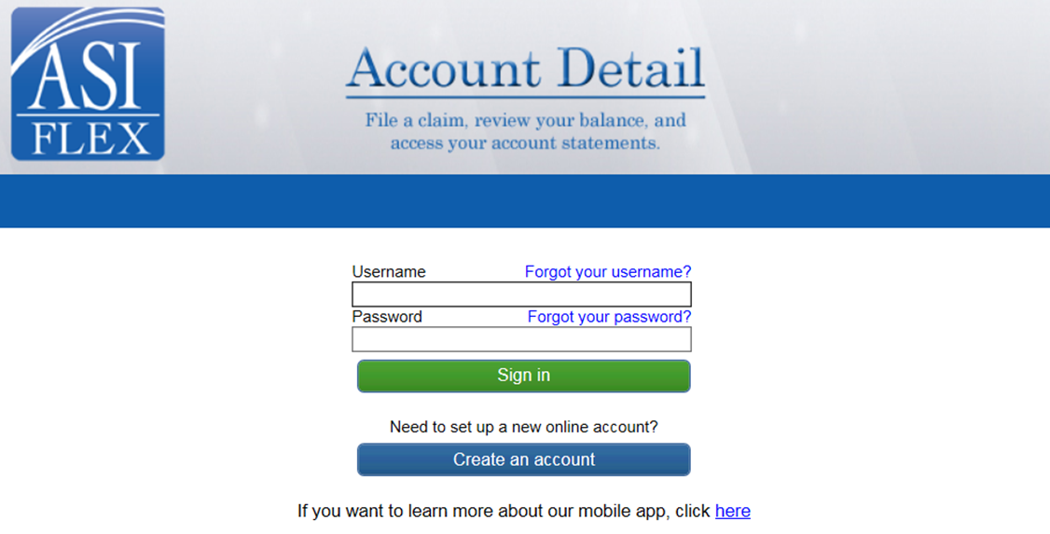
ASIFlex Online
Title of Presentation
Register to set up your online account
Submit claims securely

Slide 17
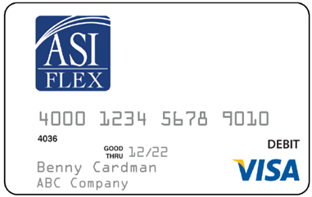
How to use the ASIFlex Card
Title of Presentation
Its easy! SWIPE – ASK – GO!
Present card for payment – swipe the card
Ask for an itemized statement of the service or supply provided to you
Then, go! Be sure to save the itemized statement and if requested, provide to ASIFlex upon request.
Use of the card is not paperless. IRS regulations require backup documentation for certain transactions.

Slide 18
Things to Know
Title of Presentation
Save all itemized provider/merchant receipts (NOT the credit card receipt)
Save all insurance payer Explanation of Benefits (EOB)
Submit documentation upon request – it’s the law!
Know your balance
Use at health care providers (note that some teaching hospitals, e.g., may not be recognized as they code terminals as “educational”)
Check your messages under your account at asiflex.com
Important: Submit documentation upon request

Slide 19
How does ASIFlex notify me?
Title of Presentation
Up to three requests are sent by email/text alert and posted to secure messages in your online account
Initial notice – Sent approximately 5 days following transaction
Reminder notice – Reminder is sent 21 days after the initial notice, and advises card may be inactivated
Final notice – Final notice is sent 21 days after the reminder notice, and advised the card is temporarily deactivated
If documentation not provided, IRS requires the card be temporarily deactivated
To remedy, simply provide documentation and card will be activated
If documentation lost, you can write a check back to the plan or submit a substitute claim

Slide 20
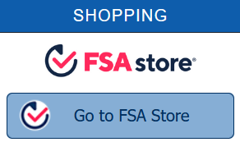
FSA Store Cardless Pay
Title of Presentation
Payment to FSA Store can be made directly from your health care FSA!
How? It’s easy!
Sign into your ASIFlex account at asiflex.com
Click on the FSA Store link to shop
Select your products and proceed to checkout
Choose the ASIFlex payment option
That’s it! ASIFlex will pay FSA Store from your account and your products will be shipped to you.

Slide 21
Claim and Debit Card Documentation
Title of Presentation
Documentation must include:
Who – for whom the service or supply is provided
What – a description of the service or supply
Where – name and address of the provider of service or supplier
When – the date the service was provided, regardless when paid or billed
Dollar amount – how much you owe
Type of Expense | Documentation Needed
If covered by medical, dental, vision insurance | Insurance payer explanation of benefits (EOB) or an itemized statement
If not covered by insurance | Itemized statement
Prescriptions | Pharmacy receipt, printout from pharmacy, itemized mail-order receipt
Over-the-counter products | Itemized merchant receipt
NOTE: Do not submit credit card receipts, paid on account or balance forward statements, cancelled checks or pretreatment estimates.

Slide 22
ASIFlex Online Resources
www.asiflex.com
Title of Presentation
Access your FSA account detail
Review messages sent to you
Manage your personal settings
Submit claims
Schedule a recurring direct payment
Shop FSA Store
From the main site, you can:
View ASIFlex Card information
View extensive eligible/ineligible expense listing
Access FSA Store with thousands of eligible FSA products
Read Frequently Asked Questions
Use the Expense Estimator & Tax Savings Calculator
View Educational videos
Access IRS Forms & Publications

Slide 23
Important Dates
Title of Presentation
Plan Year
01/01/2024 through 12/31/2024
Open Enrollment
9/18/23 through 10/13/23
Claims must be incurred:
01/01/2024 through 03/15/2025
Deadline to submit claims:
06/30/2025
Don’t wait until the last minute as you may miss the date!

Slide 24
ASIFlex Customer Service
Online: www.asiflex.com
Email: asi@asiflex.com
Phone: 800.659.3035
TTY Users: Dial 711
Live chat: Sign into your online account
Address: PO Box 6044
Columbia, MO 65203
Hours: 5 a.m. to 5 p.m. Pacific Time Monday through Friday
7 a.m. to 11 a.m. Pacific Time on Saturday
Notes:
Be sure to register your account so you can view your account statement and read secure messages sent to you.
You can email or phone ASIFlex; or sign into your online account to chat.
And for your convenience, we do offer extended customer service hours Monday through Saturday.
Thanks for attending today and now let’s take a moment and see if we have some chat questions we can help with.

